Slide 1
MT+ GUIDE FOR BENEFICIARIES

Slide 2
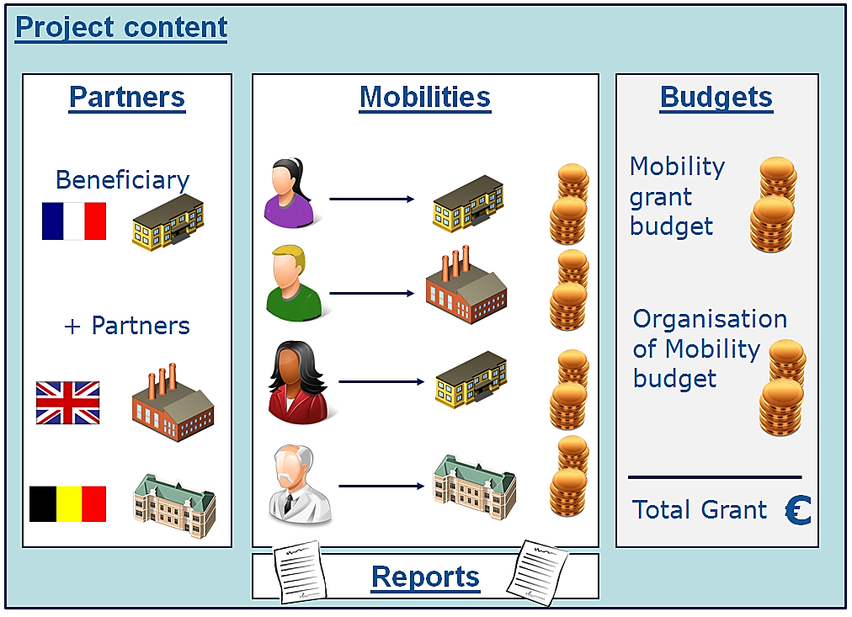
1. GENERAL INTRODUCTION

Slide 3
1.1. Mobility Tool+ users
Beneficiary organisations
National Agencies
The European Commission Directorate for Education and Culture (DG EAC)
Participants (indirect )

Slide 4
2.ACCESS TO THE APPLICATION
https://webgate.ec.europa.eu/eac/mobility
  How do I login to Mobility Tool+?
  an ECAS (European Commission Authentication Service) account and
  be registered in Mobility Tool+.

Slide 5
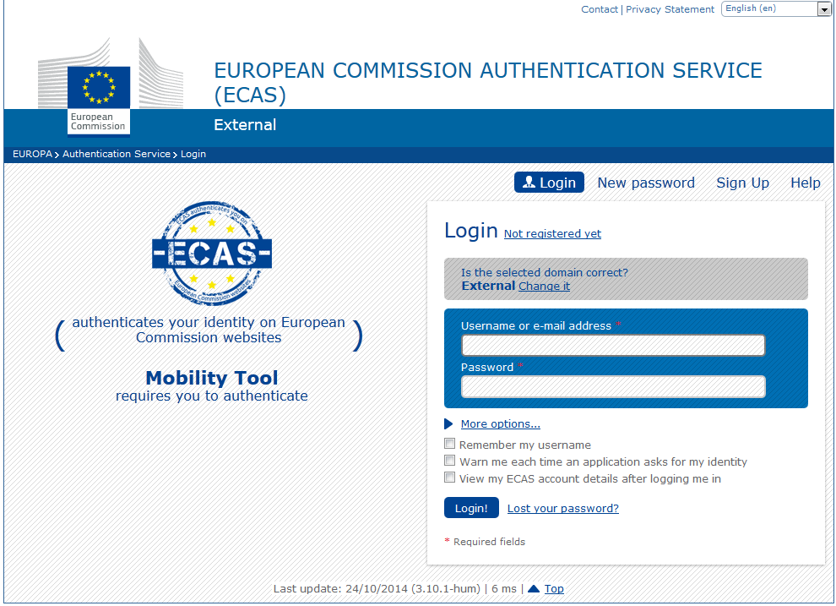
2.ACCESS TO THE APPLICATION
The most important fields
  Is the selected domain correct?
  Username or e–mail address
  Password

Slide 6
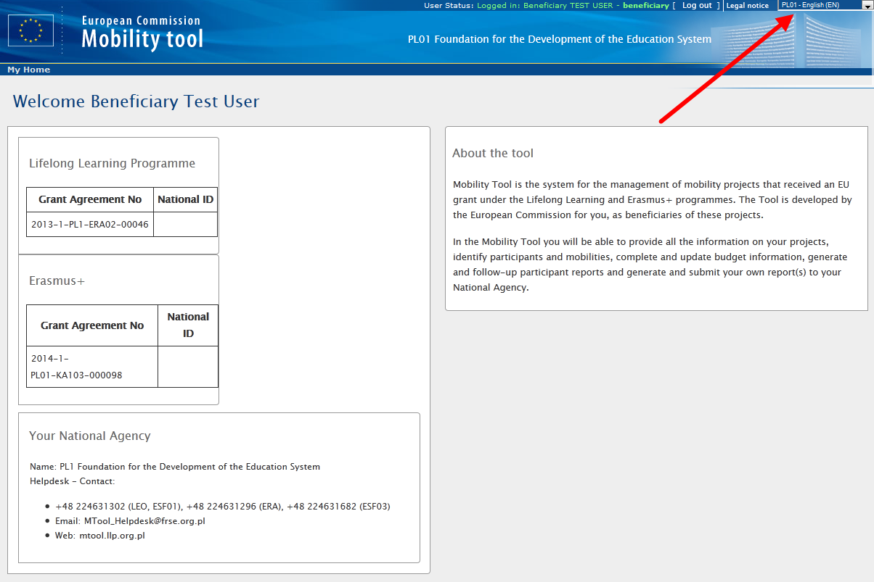
2.1.How to change language of user interface?

Slide 7
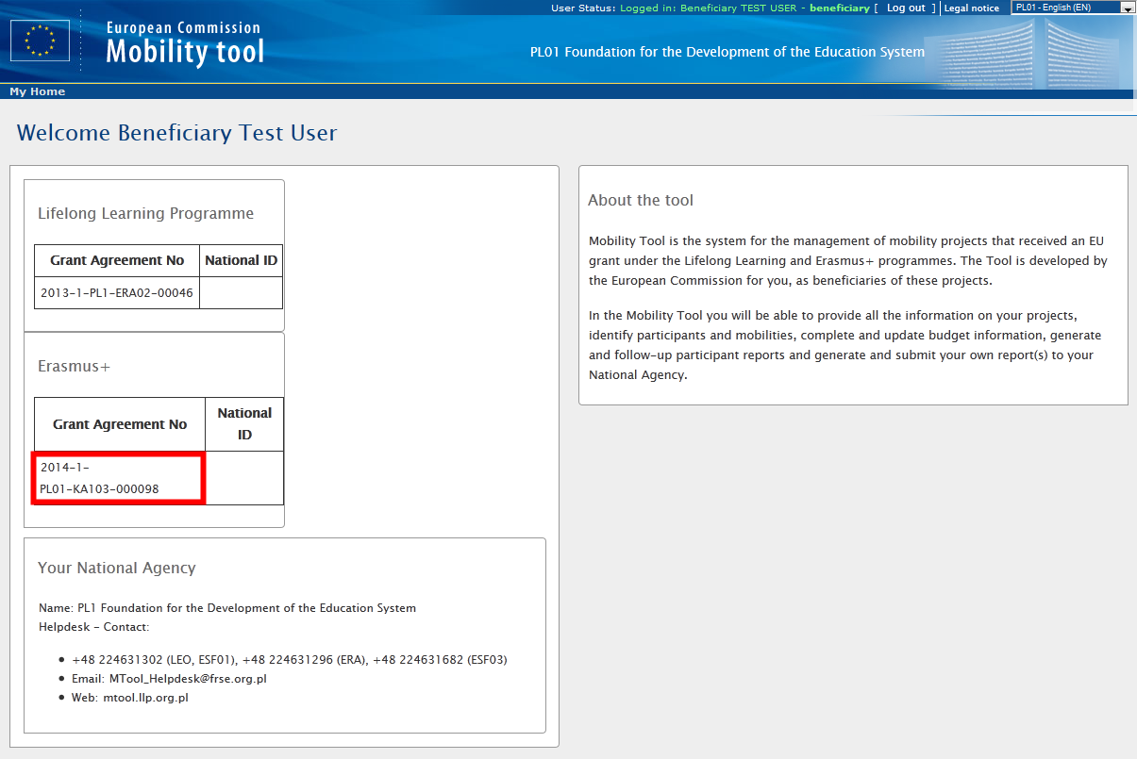
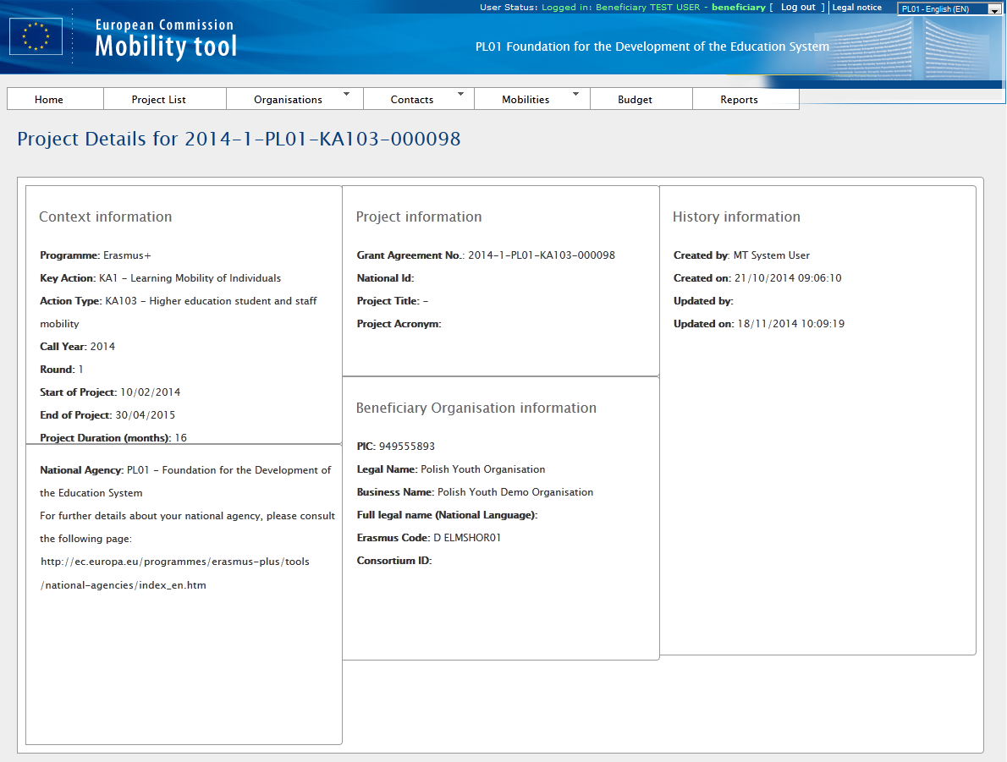
3. PROJECT
How to view project details?

Slide 8
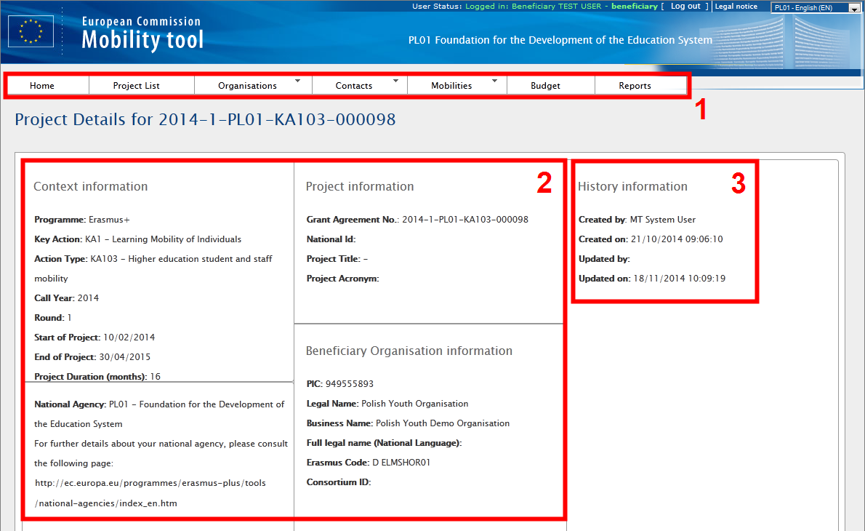
3.1.User interface overview

Slide 9
3.2. Changes to project details
    3.2.1.Manual Changes
DOs
DONTS
Organisations
Organisation contact persons
Mobilities
Participants
Budget information
All other project information
the project title
the National Agency project ID
the project activity periods
To request changes
National Agency

Slide 10
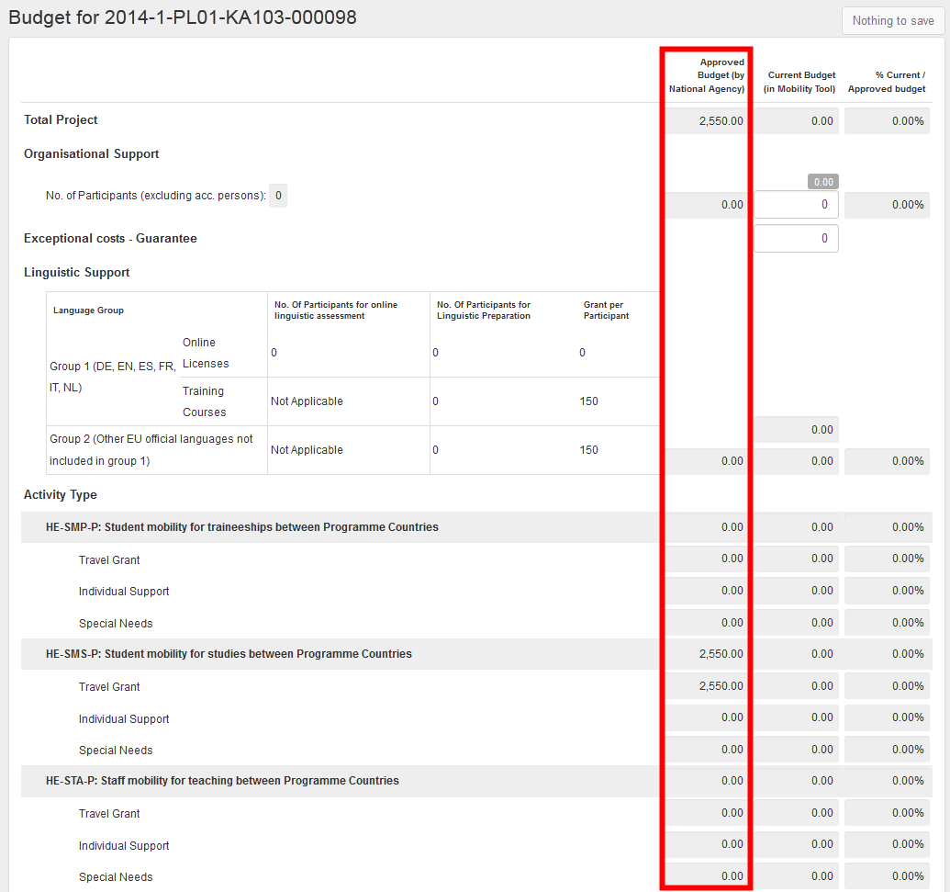
3.2. Changes to project details
    3.2.1.Automic Changes
"Approved Budget (by National Agency)" details displayed in "Budget" section of Mobility Tool+
  This can be a result of an amendment or other changes to the project.

Slide 11
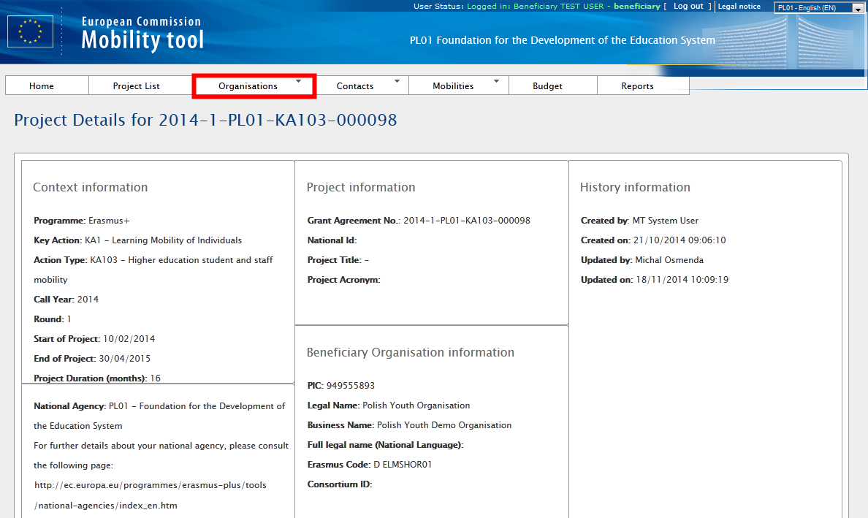

4.ORGANISATIONS

Slide 12
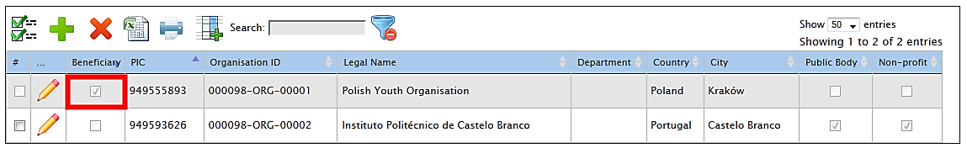
4.ORGANISATIONS

Slide 13
4.ORGANISATIONS
  4.1.How to add new organisation?
Depending on the action type of the project
  you may be required to put a PIC number of the organisation you wish to add
  In special cases you may override the PIC requirement by selecting "Non-PIC Organisation".
Partner details can be changed at any time during the project lifetime !!!

Slide 14
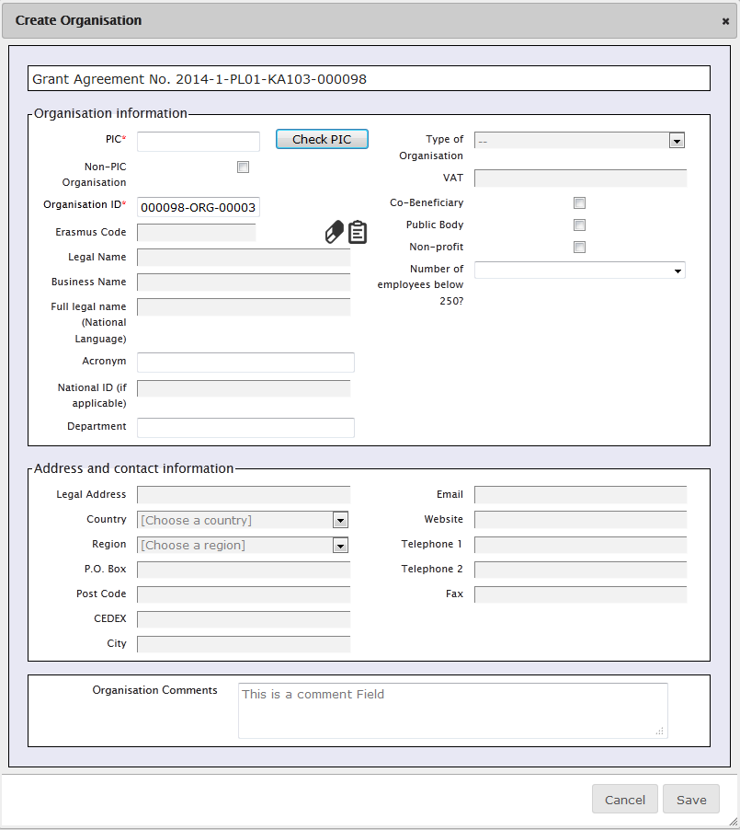


4.ORGANISATIONS
  4.1.How to add new organisation?
Organisations with PIC number
Organisations without a PIC number
tick "Non-PIC Organisation

Slide 15
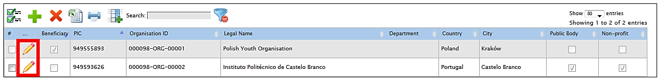
4.ORGANISATIONS
  4.1. How to edit organisation details?

Slide 16
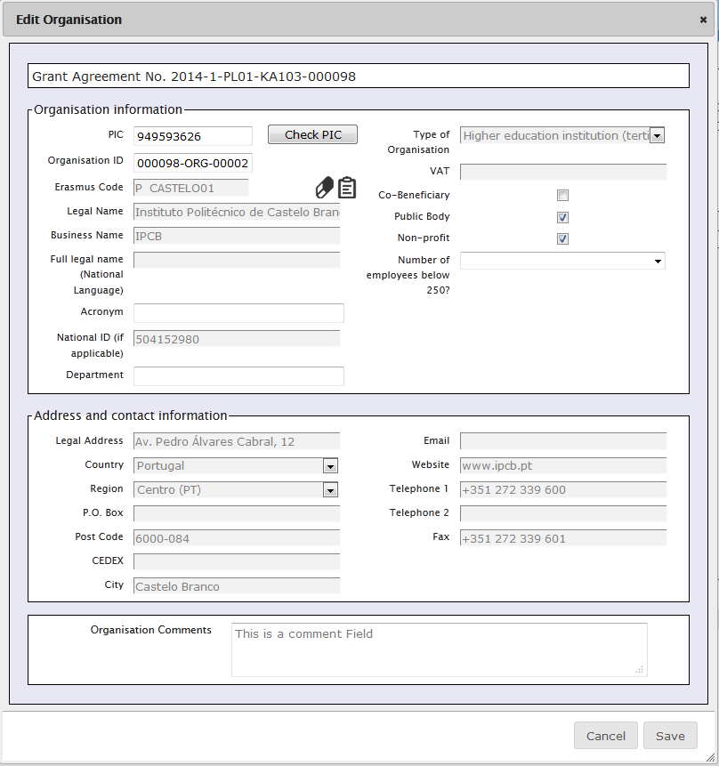
4.ORGANISATIONS
  4.1. How to edit organisation details?

Slide 17
4.ORGANISATIONS
  4.1. How to edit organisation details?

Slide 18
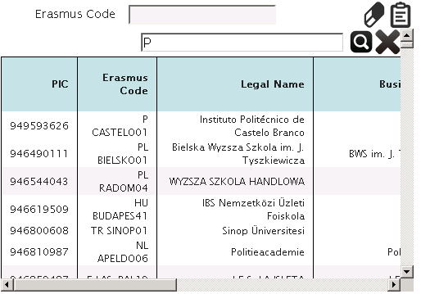
4.ORGANISATIONS
  4.1. How to edit organisation details?
Depending of the type of the organisation and/or the Action Type, the field "Erasmus Code" will appear in the organisation form
  Linked to the ECHE (Erasmus Charter for Higher Education)
  Can be used to search an organisation in the ECHE database among those Higher Education institutions who have received a Charter for Erasmus+ Programme.

Slide 19
4.ORGANISATIONS
  4.1. How to edit organisation details?
The beneficiary organisation details
  should not be changed by the beneficiary organisation, only by the National Agency
If for any reason the Beneficiary Organisation details need to be changed
  please your National Agency
  Once the data is changed by the National Agency, please reflect these changes in the project in Mobility Tool.

Slide 20

4.ORGANISATIONS
  4.2. How to export list of organisations?
Can be exported to a CSV file
  The exported list will contain exactly the same fields shown on the Organisations page
Login to Mobility Tool+
Open your project
Click "Organisations" button in the top menu
Click the Excel icon in the partner list menu
Save the exported file on your local computer

Slide 21
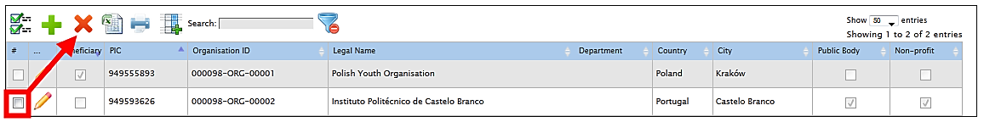
4.ORGANISATIONS
  4.3. How to remove organisation?
Login to Mobility Tool+
Open your project
Click "Organisations" button in the top menu and select "List Organisations".
Mark the selection box next to the partner you want to remove
Click the "Delete" icon

Slide 22
4.ORGANISATIONS
  4.3. How to remove organisation?
It is not possible to remove your own beneficiary organisation from the list!!
Sending and receiving organisations that are already part of entered mobilities in the project cannot be deleted!!

Slide 23
5. CONTACTS
  5.1.Who are organisation contact persons?
Organizations may have one or more contact persons for the project
  (By default) only the contact person of the beneficiary organisation and legal representative are granted access to Mobility Tool+
    These users can grant access to the project information in Mobility Tool+ to additional contact persons of her/his own organisation only (being aware that they will be able to edit and change the information of the project)

Slide 24
5. CONTACTS
  5.2. How to display contact persons?
Login to Mobility Tool+
Open your project details
Click "Contacts" from the top menu
Select "List Contacts" from the contextual menu
A table with contacts of all organisations will be displayed

Slide 25
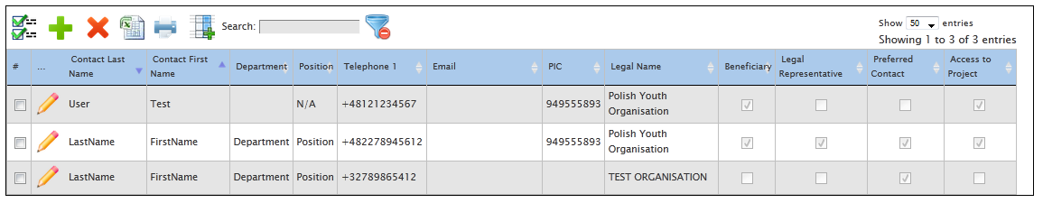
5. CONTACTS
  5.2. How to display contact persons?
Contact persons'
  Last names
  First names
  Department
  Position
  Telephone number
  Email
PIC of the organisation
Legal name of the organisation
Flag
  Whether the organisation is a beneficiary or not
  If the contact is organisation's legal representative
  Whether the contact is organisation's preferred contact
  Flag if the contact has access to the project

Slide 26
5. CONTACTS
  5.2. How to add organisation contact person?
Login to Mobility Tool+
Open your project details
Click "Contacts" from the top menu
Select "Create a new Contact" from the contextual menu
"Contact" in Mobility Tool+ page.

Slide 27
5. CONTACTS
  5.2. How to add organisation contact person?
There must be a minimum one preferred contact person within each organisation.
First contact person is automatically selected as a preferred one.
In case of the beneficiary organisation, the preferred contact or contacts will receive notifications from the Mobility Tool+ for project updates, for example.
In case of address details, selecting "Same as Organisation" will prefill the fields with data from organisation details. The address details can be modified after being prefilled with organisation address details.

Slide 28
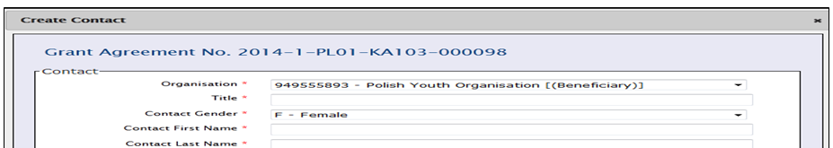
  5. CONTACTS
  5.2. How to add organisation contact person?
When the organisation chosen from "Organisation" drop-down list is the beneficiary organisation (marked with [(Beneficiary)] in the drop-down list), an additional option is displayed on the bottom of the screen – «Access to Project»
This option allows beneficiary contacts to access the Mobility Tool+ project page and manage the project details. The beneficiary contact persons must have ECAS account

Slide 29
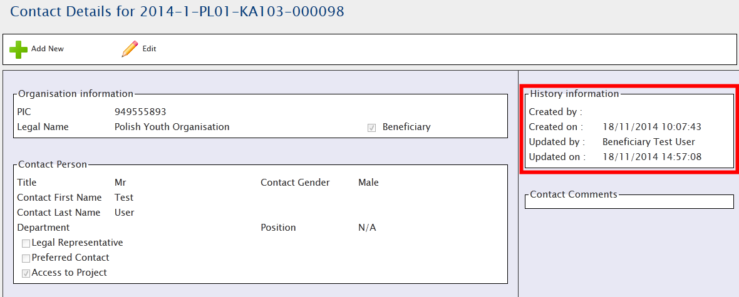
  5. CONTACTS
  5.2. How to add organisation contact person?
Every page with contact details has a section called «History Information»
  showing who created the contact and when
  displays who was the last person editing the
contact details and when did this take place.

Slide 30

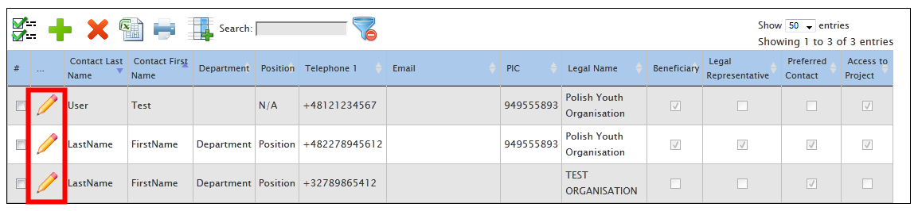
  5. CONTACTS
  5.3.How to edit contact person details?
Login to Mobility Tool+ Open your project details
Click "Contacts" from the top menu
Select "List Contacts" from the contextual menu.
Click the pencil icon next to the details of the person you wish to edit.
Page with the contact details will be displayed. Click "Edit".

Slide 31
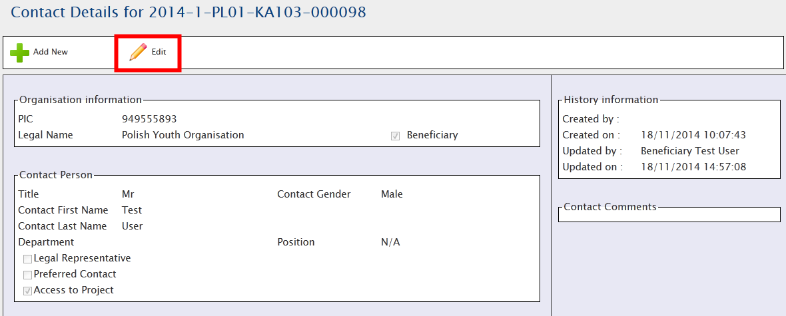
  5. CONTACTS
  5.3.How to edit contact person details?
Edit form page will be displayed. Change the data and click "Save" button on the bottom of the page to save the details.

Slide 32
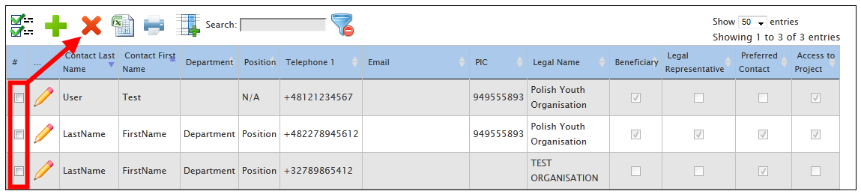
  5. CONTACTS
  5.4.How to remove organisation contact person?
Login to Mobility Tool+ Open your project details
Click "Contacts" from the top menu
Select "List Contacts" from the contextual menu
Tick a box next to a contact person you wish to remove. Click the "Delete" icon

Slide 33
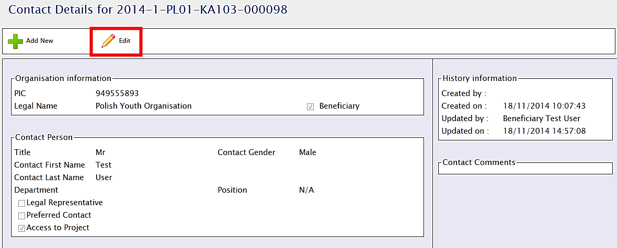
  5. CONTACTS
  5.5. How to enable or disable access to Mobility Tool+ website for other users?
Login to Mobility Tool+ Open your project details
Click "Contacts" from the top menu
Select "List Contacts" from the contextual menu
Click the pencil icon next to the details of the person you wish to grant or to revoke access for
Page with the contact details will be displayed. Click "Edit"
Edit form page will be displayed. Check the bottom of the screen for "Access to Project" option.

Slide 34
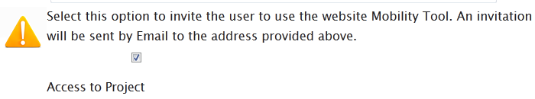
  5. CONTACTS
  5.5. How to enable or disable access to Mobility Tool+ website for other users?
By ticking the box for "Access to Project" you give the contact person access to the project in Mobility Tool+. Similarly, by de-selecting this option you revoke the contact person access to the tool.

Slide 35
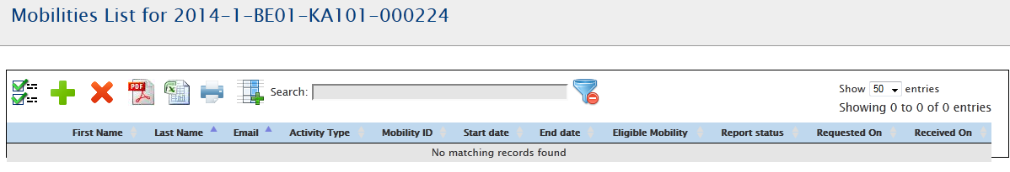
  6. MOBILITIES
  6.1.How to display list of mobilities?
Login to Mobility Tool+ Open your project details
Click «Mobilities» from the top menu
Select "List Mobilities" from the contextual menu.
If you only opened the Mobility Tool+ and your project for the first time, most likely you will see an empty page informing you that there are "no matching records found".

Slide 36
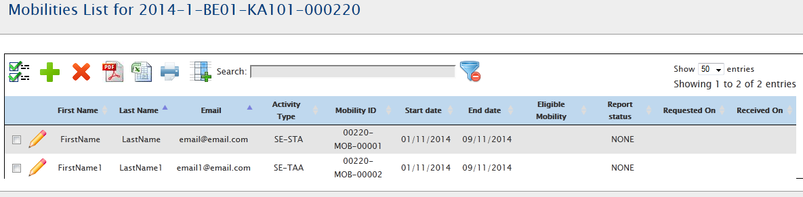

6. MOBILITIES
6.1.How to display list of mobilities?
If there are mobilities in the project
You can modify what columns should be displayed by using the «Add/Remove Columns» button.

Slide 37
  6. MOBILITIES
  6.2.How to add new mobility?
Login to Mobility Tool+ Open your project details
Click «Mobilities» from the top menu
Select "List Mobilities" from the contextual menu.
Click the + button to add new entry
Depending on the type of activity and on the action type of your project you may see different fields in this screen and you may observe different behaviour in the calculation and in the validation of the information.
However, the main fields, marked with the red asterisk must be provided.

Slide 38
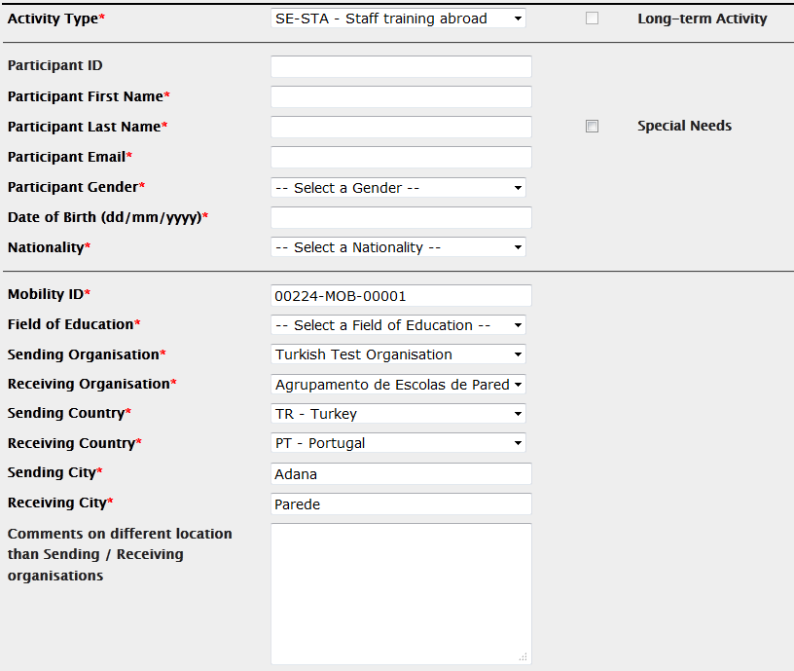
  6. MOBILITIES
  6.2.How to add new mobility?
The mobility page can be split into 3 sections:
General information about the mobility
  Details of the participant's mobility
  The mobility action type
  Participant's sending and receiving countries and locations.
  Participants email, gender, date of birth, nationality, field of education, and flag for special needs
  The section includes a comment field useful for providing any extra information concerning location of the sending or receiving organisations

Slide 39
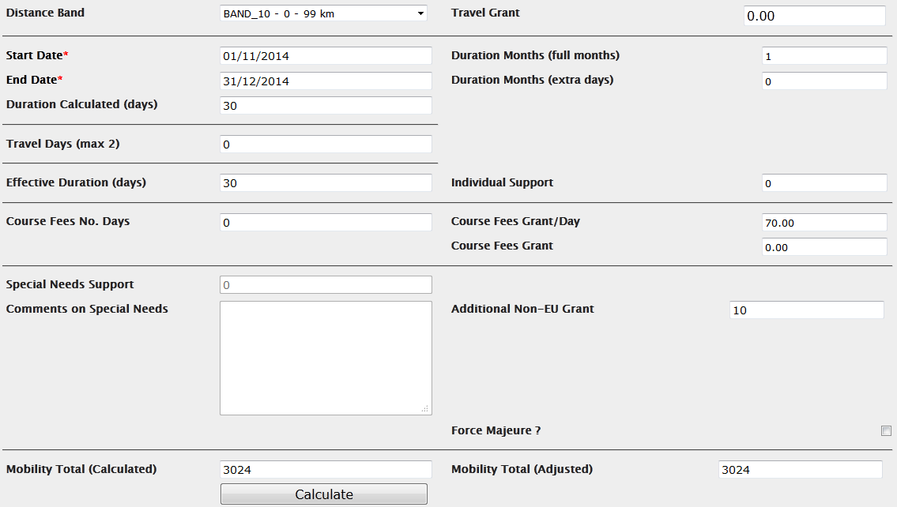
  6. MOBILITIES
  6.2.How to add new mobility?
The mobility page can be split into 3 sections:
2. Budget
Some important financial information about the mobility
  Distance band between the two locations indicated in the first section of the screen
  Start and end date of the mobility
  Sending, receiving countries
  Activity type
  The calculation of a grant for the participant

Slide 40
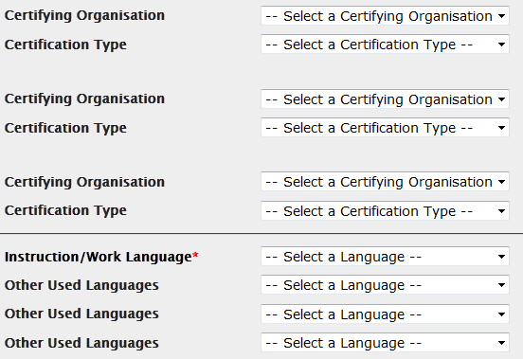
  6. MOBILITIES
  6.2.How to add new mobility?
The mobility page can be split into 3 sections:
3.Certification and language section
(May differ according to the action and activity type)
You can specify any certifications that the participant might have received or will receive from organisations involved in the mobility.
  Please note that the list of organisations is taken from the "Organisations" page of the Mobility Tool+.
The main instruction or working language of the mobility can be selected. On top of that up to 3 other languages of the mobility can be entered.

Slide 41

  6. MOBILITIES
  6.2.How to add new mobility?
SMALL TIPS BEFORE CALCULATING BUDGET
The sending and receiving organisation drop-down list are pre-filled with the list of organisations in the "Organisations" tab. If you are missing some organisations from either of these two drop-down lists, please enter them first on the "Organisations" page.
The sending and receiving cities are pre-filled based on the cities of the sending and receiving organisations. These fields can be changed
For correct budget calculation, fields such as activity type, sending and destination country, mobility start and end date must be filled in and correct distance band must be selected.

Slide 42
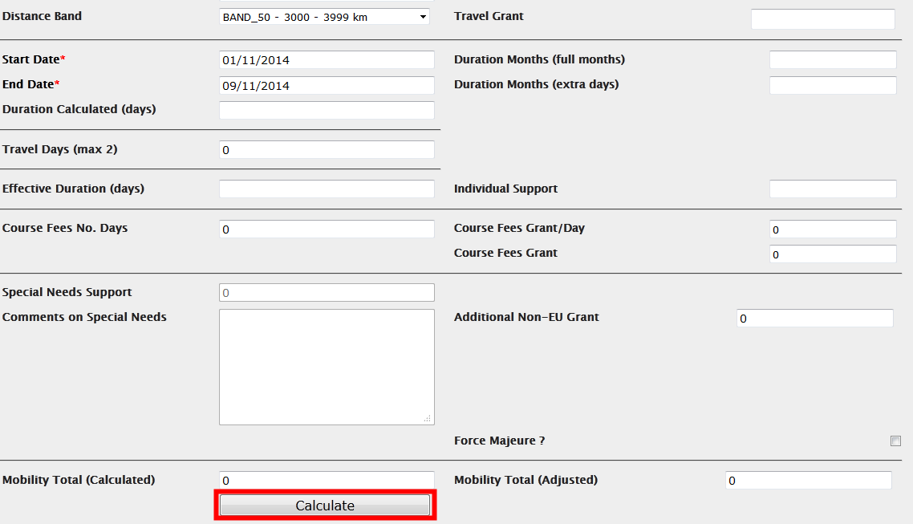
  6. MOBILITIES
  6.2.How to add new mobility?
The "Calculate" function will fill in the duration fields and all fields related to grants that have been defined on European or national level
After the calculation
  almost all fields in this budget section of the mobility form become locked

Slide 43
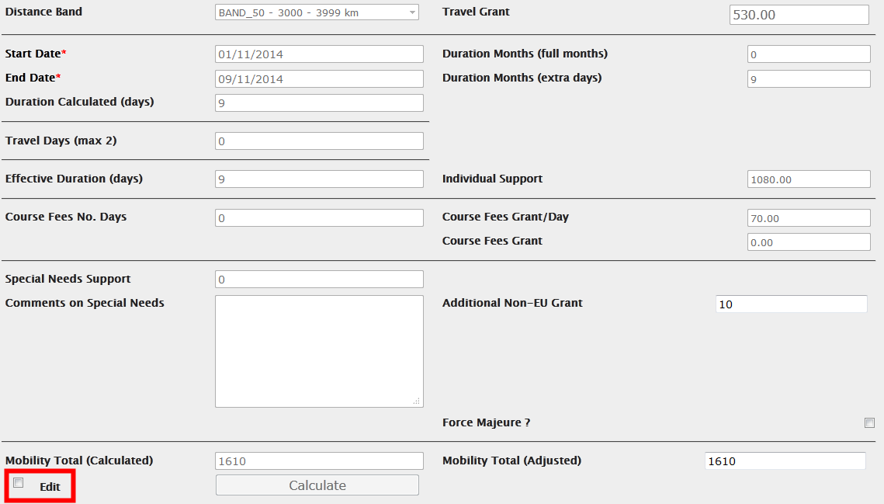
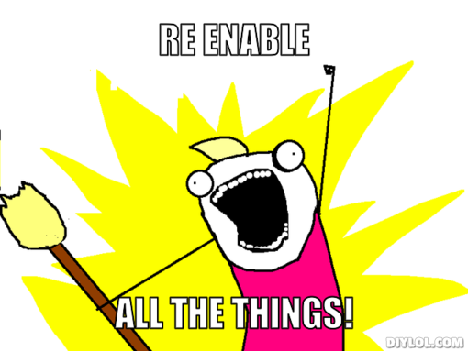
  6. MOBILITIES
  6.2.How to add new mobility?
If you wish to edit the values or add additional travel days or days for courses
  you may tick the "Edit" field located nearby the "Calculate" button
  The "Edit" option will re-enable previously locked fields for your corrections.

Slide 44

  6. MOBILITIES
  6.2.How to add new mobility?
In this case, the user has chosen wrong duration of the mobility for the specified activity type.
Correcting the duration and pressing the "Calculate" button again fixes the issue.
Errors in budget calculations

Slide 45
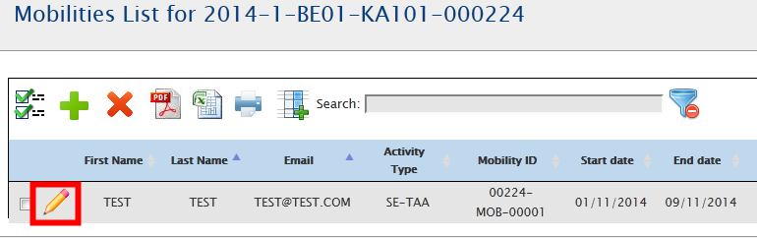
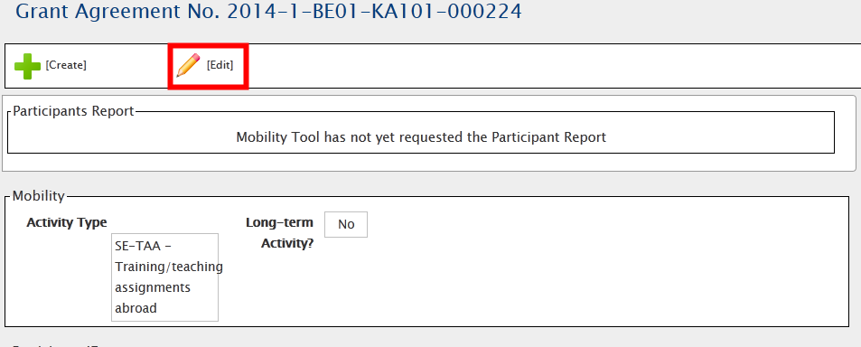
  6. MOBILITIES
  6.3. How to change mobility details?
Login to Mobility Tool+ Open your project details
Click "Mobilities" from the top menu. "
Select "List Mobilities" from the contextual menu.
Click on the pencil icon next to the mobility you need to edit.
A page with the details of the mobility will open.
To edit, click the pencil icon again.

Slide 46
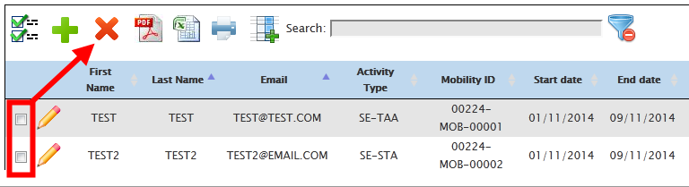
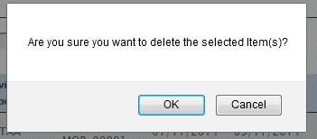
  6. MOBILITIES
  6.3. How to change mobility details?
Login to Mobility Tool+ Open your project details
Click "Mobilities" from the top menu. "
Select "List Mobilities" from the contextual menu.
To delete, you can select one or many mobilities by ticking the box in the first column and choose the red x button

Slide 47
  6. MOBILITIES
  6.4. Import and export of mobility data
Main purpose of data import
Enable beneficiaries of big projects to enter large amount of data into the Mobility Tool+ in a more efficient manner than manually through the interface.

Slide 48

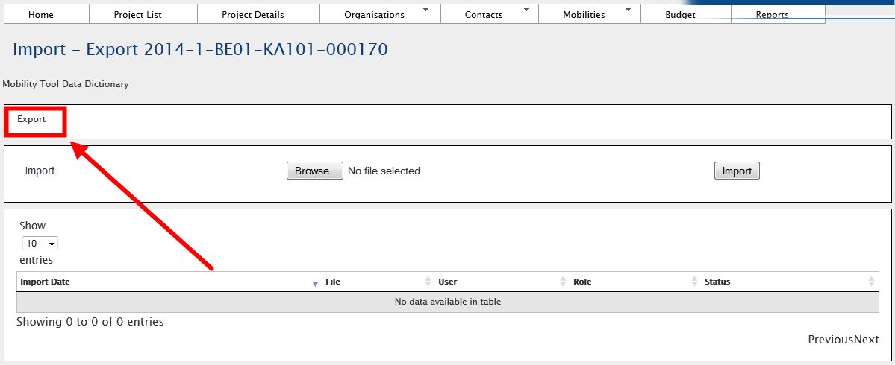
  6. MOBILITIES
  6.4. Import and export of mobility data
Available from the "Mobilities" menu
When exported, data from Mobility Tool+ projects is saved in CSV

Slide 49
  7. Participant reports
Provide information about the Erasmus+ projects participants' experience
Each participant receives an invite to fill in the participant report at the end of their mobility period.
The message sent to the email address indicated in the details of the participant's mobility includes a link to a website.

Slide 50
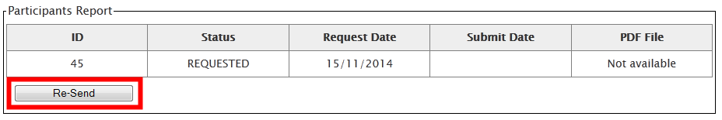
  7. Participant reports
  7.1. How to request participant reports?
Mobility Tool+ sends out requests for participant reporting automatically after the end of the mobility period, as indicated in the "End date" field of the mobility details
When the report is in status "REQUESTED", the report can be re-requested.

Slide 51
  7. Participant reports
  7.1. How to request participant reports?
To re-send the report request;
Login to Mobility Tool+ Open your project details
Click "Mobilities" from the top menu. "
Select "List Mobilities" from the contextual menu.
Edit the mobility details and click button "Re-Send" in the "Participant Report" section
When the mobility period is not over or when the participant report is already in status "SUBMITTED" re-sending participant report is not available.

Slide 52
  7. Participant reports
  7.2. How to check participant report status?
NONE – no invite for a report has been sent yet
REQUESTED – invitation to fill in the report has been sent out to the participant
SUBMITTED – the participant has submitted his/her report
To see status of the participant reports in your project;
Login to Mobility Tool+ Open your project details
Click "Mobilities" from the top menu. "
Select "List Mobilities" from the contextual menu.
The status of the participant reports will be displayed in the "Report status" column.

Slide 53
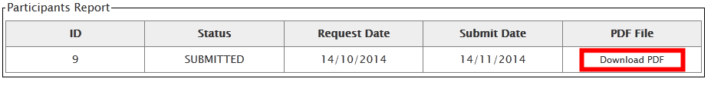
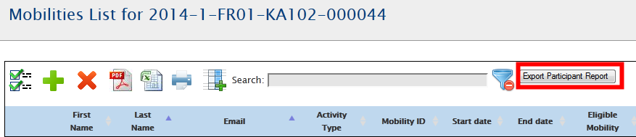
  7. Participant reports
  7.3. How to see results of participant report?
Login to Mobility Tool+ Open your project details
Click "Mobilities" from the top menu. "
Select "List Mobilities" from the contextual menu.
Edit the mobility for which you'd like to see the participant report.
Click "Download PDF" link in the "Participants Reports" section to download a PDF version of the participant report results.
Alternatively

Slide 54
  8. BUDGET
A summary of the financial details of mobilities and other financial elements of the project.

Slide 55
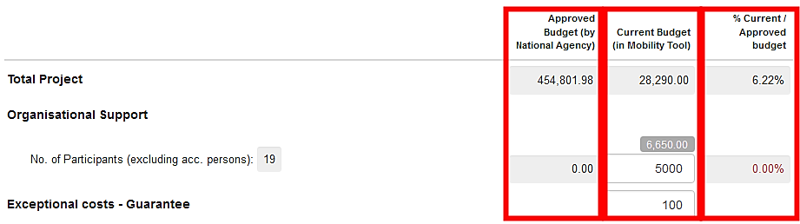
  8. BUDGET
  8.1.What are the elements of project budget on the "Budget" page?
Two sources of information
Project budget as granted by the National Agency
Project budget as a summary of project activities.
***For easier budget management, a third column % Current / Approved budget" provides the current level of budget consumption.

Slide 56
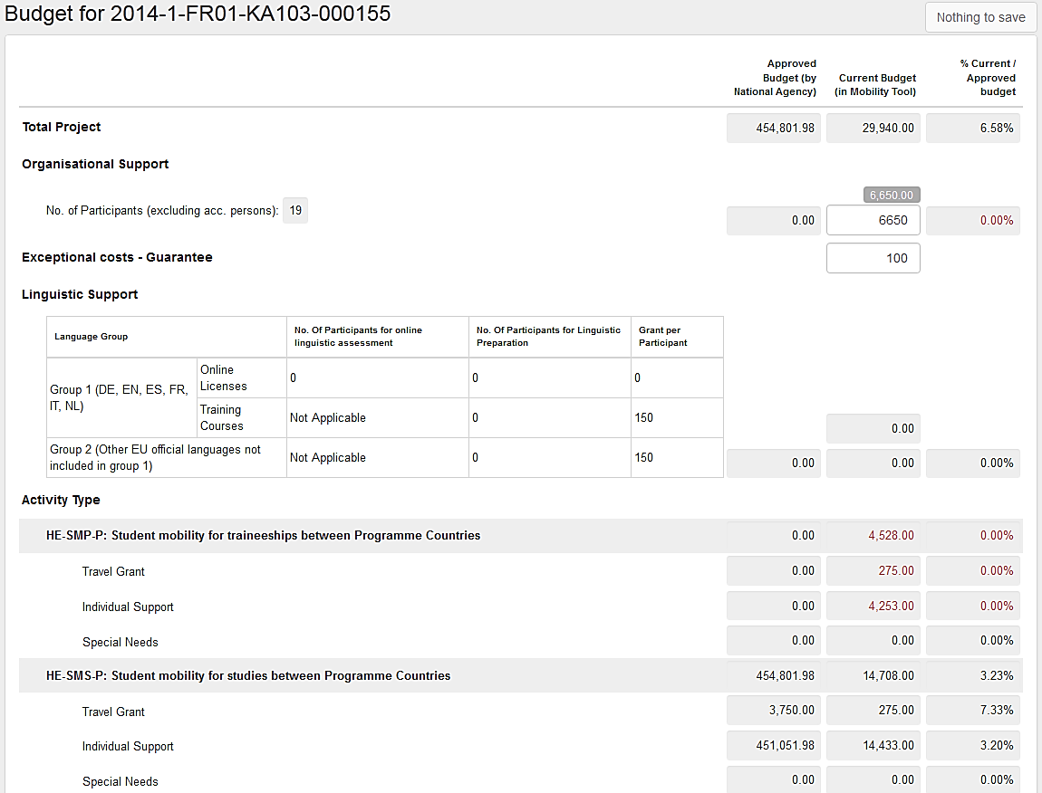
  8. BUDGET
  8.2. How to check project budget?
Login to Mobility Tool+ Open your project details
Click "Budget" in the top menu.
A budget page will be displayed.

Slide 57
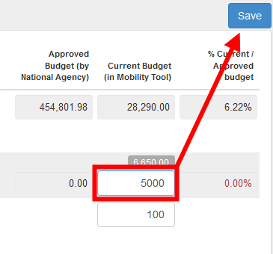
  8. BUDGET
  8.3. How to change project budget?
Login to Mobility Tool+ Open your project details
Click "Budget" in the top menu. A budget page will be displayed.
Edit fields which are editable
Once you make a change, a button that was previously called "Nothing to change" on the top of the page changes into "Save".

Slide 58
  9. REPORTS
Provides you a reporting functionality as beneficiary.
This section can be used to submit interim and final beneficiary reports to your National Agency.
The final report will contain a summary of all the activities of your project, the project budget and some additional information.
Most of the content of the report will be prefilled with the data you have entered in Mobility Tool+.
Additionally, you will be asked series of questions concerning the implementation of your project.
Depending on the action type of your project, the form of the final report can be a PDF form or a website form.

Slide 59
  9. REPORTS
  9.1. How can I submit my final report to NA?
Login to Mobility Tool+ Open your project details
Click "Generate Beneficiary Report« and choose the language of the report.
The processing of your request will go through 3 stages of generating the file and submitting the report.
Click "Download Beneficiary Report" to download the final report PDF file.
Click "Reports" in the top menu.

Slide 60
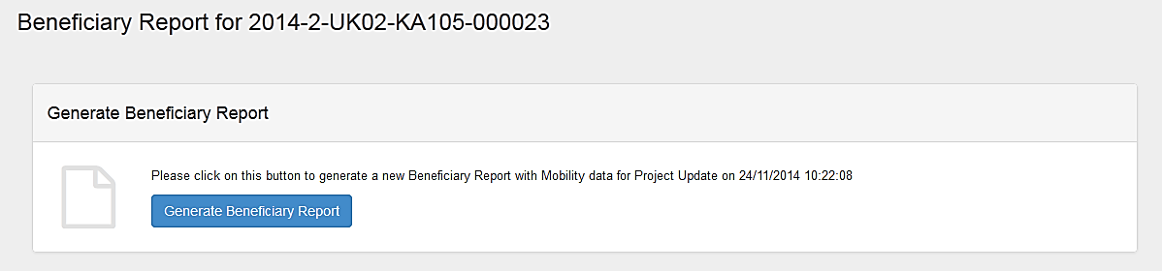
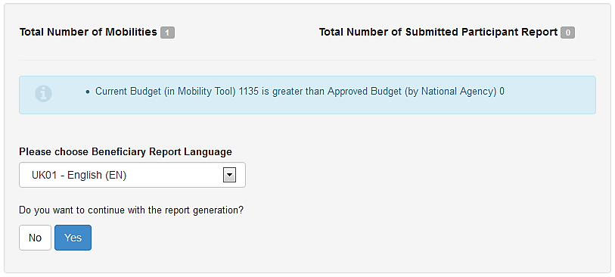
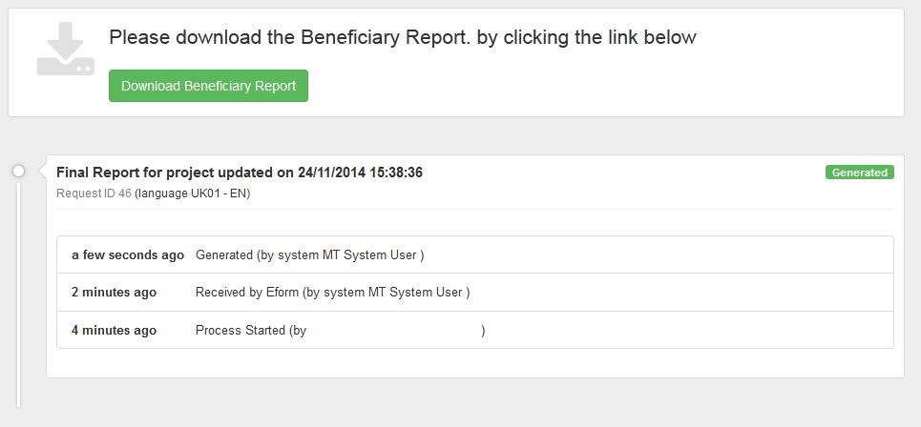
  9. REPORTS
  9.1. How can I submit my final report to NA?

Slide 61

  9. REPORTS
  9.2. What happens after I submit my final report?
Your access to your project in Mobility Tool+ will be restricted.
  You will be able to read data, but not to change it.
  A warning similar to the one below will be displayed on all pages of your project.

Slide 62
  9. REPORTS
  9.3. How can I edit my project after final report submission?
National Agency may restore your access to the project if the final report is found to be unsatisfactory or your project requires further changes.
In either way you will receive a notification from the National Agency.

Slide 63


